Slide 1
XPath

Slide 2
What is XPath?
XPath - Navigate through elements and attributes in an XML document.
  It provides syntax for defining parts of an XML document
  It uses path expressions to navigate in XML documents
  It is a major element in XSLT
  It is a W3C Standard

Slide 3
Relationships of nodes
Parent - Each element and attribute has one parent.
• Children - Element nodes may have zero, one or more children.
• Siblings - Nodes that have the same parent.
• Ancestors - A node's parent, parent's parent, etc.
• Descendants - A node's children, children's children, etc.

Slide 4
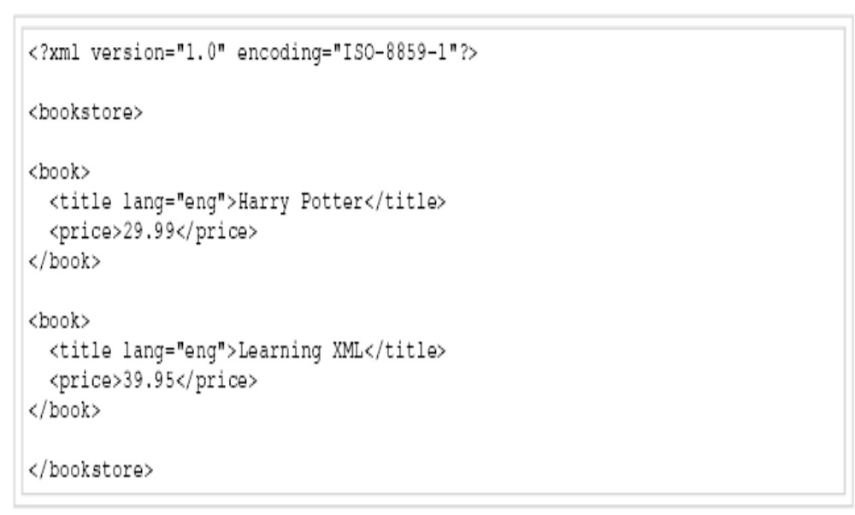
Sample book.xml

Slide 5
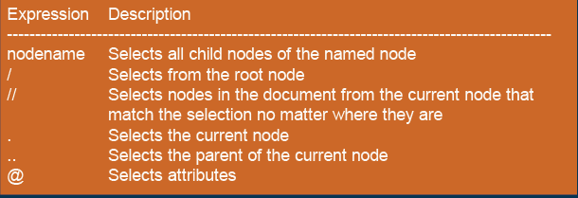
Selecting Nodes
Xpath uses the path expression to select a node

Slide 6
Selecting nodes
1.bookstore 2./bookstore
3. /bookstore/book 4. //book
5. bookstore//book 6. //@lang
7. /bookstore/book[1] 8./bookstore/book[last()]
9. /bookstore/book[last()-1]
10./bookstore/book[position()<3]
11.//title[@lang] 12./title[@lang='eng']
13./bookstore/book[price>35.00]
14. /bookstore/book[price>35.00]/title

Slide 7
Selecting Nodes
Bookstore - Selects all the child nodes of the bookstore element
/bookstore Selects the root element bookstore.
Note: If the path starts with a slash ( / ) it always represents
an absolute path to an element!
bookstore/book Selects all book elements that are children of bookstore
//book Selects all book elements no matter where they are in the document
bookstore//book Selects all book elements that are descendant of the bookstore
element, no matter where they are under the bookstore element
//@lang

Slide 8
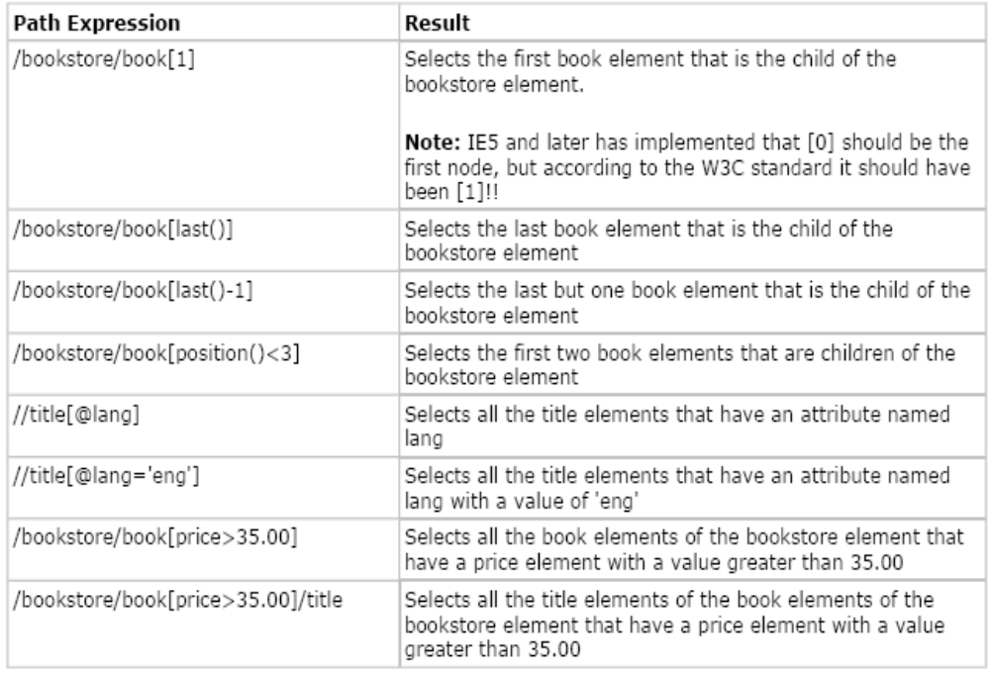
Predicates

Slide 9
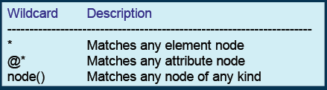
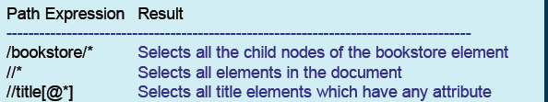
Wild Cards

Slide 10
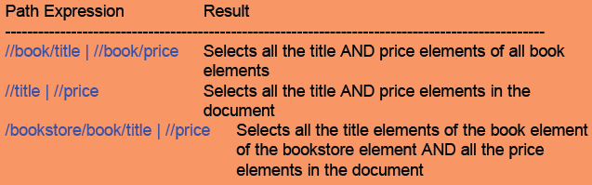
| operator

